Slide 1
Dot net core

Slide 2
Introduction
Dot net core is a modular, cross-platform and open source framework distributed as NuGet packages
Supported by .NET Foundation. It serves as a forum for community and commercial developers alike to broaden and strengthen the future of the .NET ecosystem
Provides Console, ASP.Net and .Net Native (Universal Windows Platform Apps)
NET Native is included within the Microsoft.NETCore.UniversalWindowsPlatform NuGet package.
.Net Standard for establishing greater uniformity in the .NET ecosystem.
.Net Standard is designed as a common standard so that .NET 4.5, Core, UWP, Xamarin and everything else has a standard to target.

Slide 3
.NET Framework vs .NET Core
.NET Framework | .NET Core
.NET Framework supports Windows and Web applications, you can use Windows Forms, WPF, and UWP to build Windows applications. | .NET Core supports UWP and ASP.NET Core applications.
It provides the complete .NET assemblies and it is faster | .NET Core is a lightweight, modular and ultra fast
.NET Framework is better now in terms of User interface centric Web applications as it has lot of features | It is still evolving, will take sometime to catch up
Does not support non windows | Supports Windows, Linux, Mac, and some other operating systems
.NET Framework has a been around since 2001, so it is stable | It’s just born

Slide 4
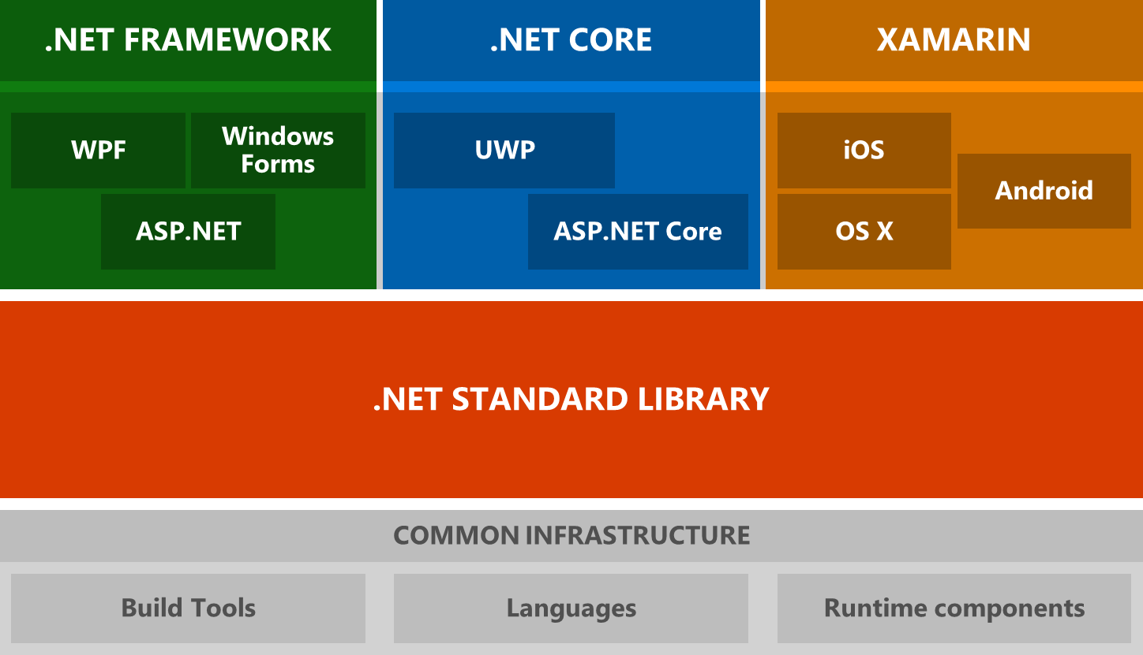
.NET Architectural Components CLI
C# Code
VB.NET Code
F# Code
Compiler
Compiler
Compiler
Common Intermediate Language (CIL)
Common Language Runtime (CLR)
0101001
Notes:
It has .NET Core, .NET Framework, and Mono for Xamarin runtime components (JIT and Garbage Collector)

Slide 5
Tools
Dot NET Core CLI
It provides the command line tools for developing .Net applications
Kestrel
It is a cross-platform web server for ASP.Net core
It is included by default in ASP.NET Core new project templates
We must use IIS, Nginx, or Apache as a reverse proxy server. A reverse proxy server receives HTTP requests from the Internet and forwards them to Kestrel after some preliminary handling.
Omnisharp
Lightweight development tools for .NET Core.
It is a C# extension for Visual Studio Code, atom and Sublime
It provides C# editing support, including Syntax Highlighting, IntelliSense, Go to Definition, Find All References, etc.
Provides debugging support for .NET Core and supports wide variety of Operating systems.
MSBuild, the build engine used to build projects

Slide 6
Build and Publish
To build all the projects in the current folder, you can simply use dotnet build or dotnet msbuild
To build a specific project, use dotnet build <project_name>
Use bundleconfig.json file to bundle and minification
To run the application dotnet run
You can set or specify the environment when you run
set ASPNETCORE_ENVIRONMENT=Development
(OR)
dotnet run --environment “Development”
To publish the project, use dotnet publish “path”
Note: Please make sure you set the proxy in .nuget/NuGet.NuGet.config file, please find the sample below in Notes window.
<environment names="Development"> </environment> <environment names="Staging,Production"> </environment>
Notes:
<?xml version="1.0" encoding="utf-8"?>
<configuration>
<config>
<add key="http_proxy" value="http://<proxy_address>:port" /> <!– If you are using Squidman or any other, set “127.0.0.1:<port number>”-->
<add key="http_proxy.user" value=”domain\username" /> <!– You don’t need to set this if you are using Squidman or any other -->
<add key="http_proxy.password" value=”password" /> <!– You don’t need to set this if you are using Squidman or any other -->
</config>
<packageSources>
<add key="nuget.org" value="https://api.nuget.org/v3/index.json" protocolVersion="3" />
</packageSources>
</configuration>

Slide 7
.NET Watch
It is a tool that runs dotnet command when source files change
To install this, we need to add the below to .csproj file
Run dotnet restore, this installs the watcher tools
The following commands are to run and watch
You can set DOTNET_USE_POLLING_FILE_WATCHER to 1 or true to use a polling file watcher instead of CoreFx's FileSystemWatcher
<ItemGroup> <DotNetCliToolReference Include="Microsoft.DotNet.Watcher.Tools" Version="1.0.0" /> </ItemGroup>
Command
dotnet watch run | This is to watch and run the application
dotnet watch test | This is to watch and run the test cases

Slide 8
Dependency Injection
.NET Core has built-in dependency injection, is designed from the ground up to support and leverage dependency injection.
It has a built-in container (represented by the IServiceProvider interface) that supports constructor injection by default.
It is responsible for providing instances of types that are requested from it.
We can register framework dependencies and application dependencies in the ConfigureServices method in the Startup class
services.AddTransient<IAppRepository, AppRepository>();
There are some framework provided extensions such as AddDbContext, AddIdentity, and AddMvc
We can register our own application services using any of the below extension methods such as AddTransient, AddScoped, and AddSingleton

Slide 9
DI Extension Methods
Transient - Transient lifetime services are created each time they are requested. This lifetime works best for lightweight, stateless services.
Scoped - Scoped lifetime services are created once per request.
Singleton - Singleton lifetime services are created the first time they are requested

Slide 10
References
https://dotnetfoundation.org
https://blogs.msdn.microsoft.com/dotnet/2017/01/30/announcing-net-core-net-native-and-nuget-updates-in-vs-2017-rc/
https://github.com/OmniSharp/omnisharp-vscode
https://docs.microsoft.com/en-us/aspnet/core/fundamentals/servers/kestrel
https://github.com/aspnet/DotNetTools
https://docs.microsoft.com/en-us/aspnet/core/fundamentals/dependency-injection

